Slide 1
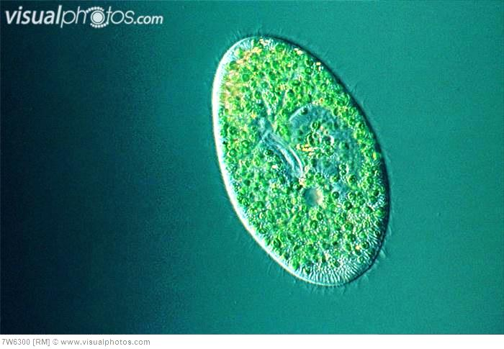
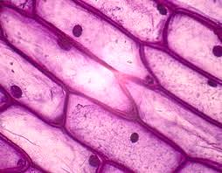
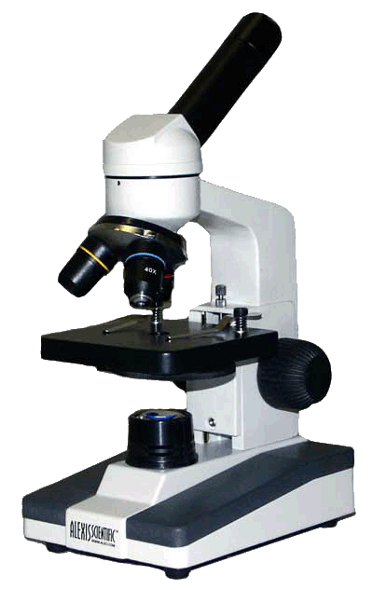
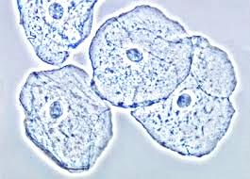
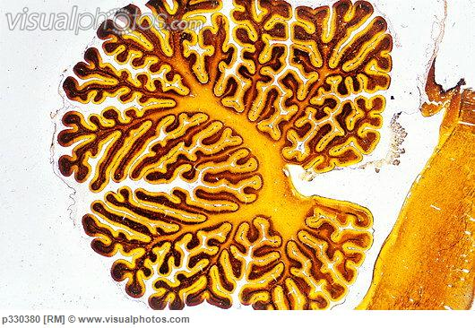
MICROSCOPE PARTS

Slide 2
LEARNING OBJECTIVES
By the end of the class:
Students will be able to describe the parts of a microscope
Students will be able to describe and adjust magnification on the microscope
Students will be able to describe safety procedure for using the microscope and preparing slides
Students will be able to prepare a cell for use with a microscope - plant and cheek cell

Slide 3
CONCEPTS EXPLORED IN THIS LESSON
eyepiece
body tube
arm
base
light source/illuminator
revolving/rotating eyepiece
objective lenses
coarse adjustment knob
fine adjustment knob
stage
stage clips
condenser lens
diaphragm

Slide 4
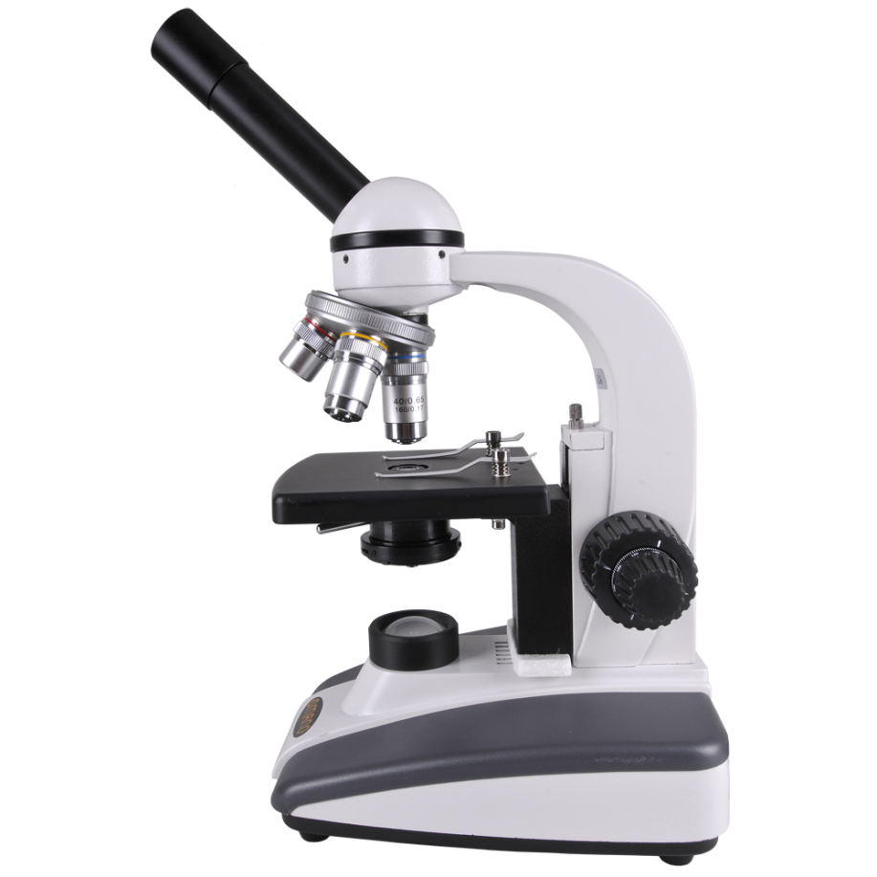
PARTS OF THE COMPOUND LIGHT MICROSCOPE
Do you know some of these parts?
Label as many parts as you can using the terms provided.
revolving nosepiece
A
B
arm
diaphragm
F
ocular lens / eyepiece
condenser
G
C
objective lenses
K
stage clips
body tube
J
H
base
L
I
light source / illuminator
M
coarse adjustment knob
D
E
stage
fine adjustment knob

Slide 5
PARTS OF THE COMPOUND LIGHT MICROSCOPE
Did your labels look something like this?
A
eyepiece
B
body tube
F
revolving/rotating nosepiece
objective lenses
G
C
arm
stage clips
K
stage
J
H
coarse adjustment knob
condenser
L
I
fine adjustment knob
diaphragm
M
light source/
illuminator
E
D
base

Slide 6
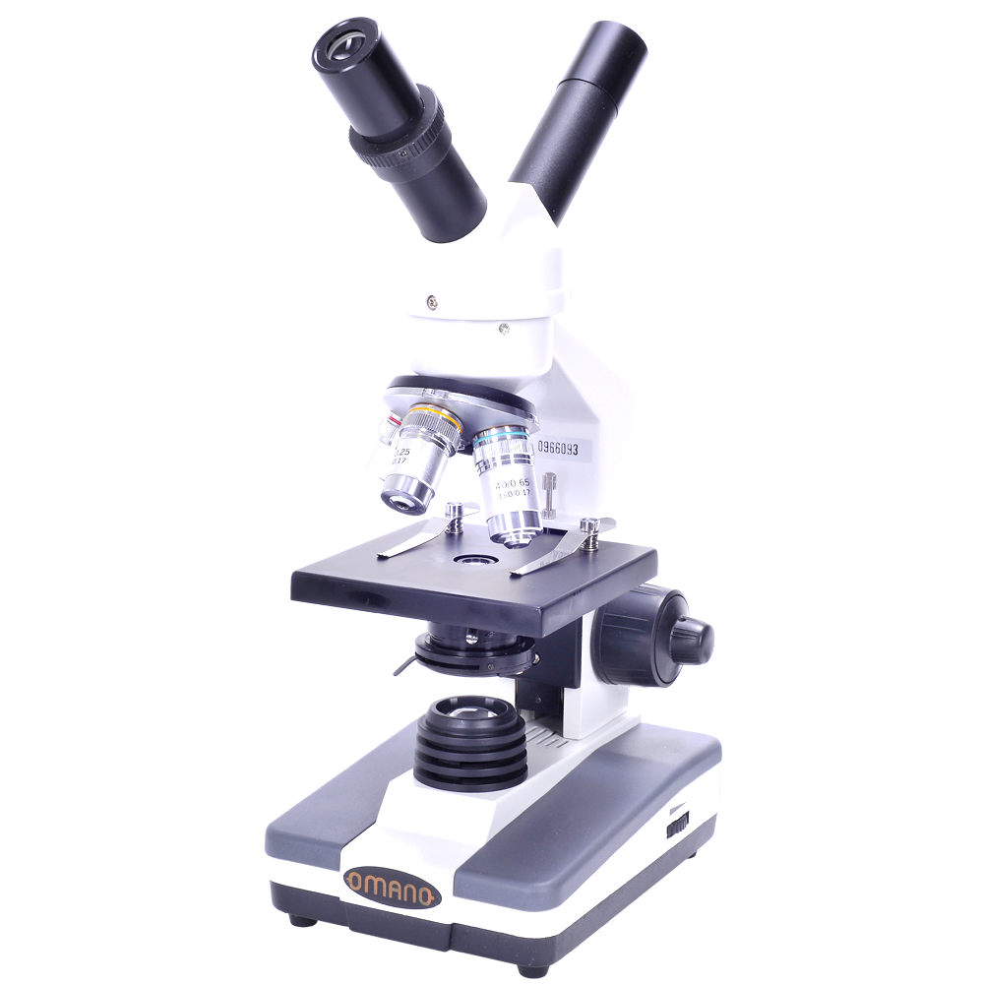
PARTS OF THE COMPOUND LIGHT MICROSCOPE
Eyepiece
A
magnify
Contains a lens to _______ the image of the specimen.
10
The usual magnification is ___ X.

Slide 7
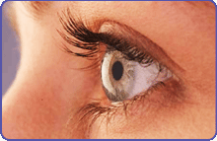
PARTS OF THE COMPOUND LIGHT MICROSCOPE
Body Tube
B
connects
It ________ the eyepiece to the objective lenses.
alignment
It ensures the correct ________ of the microscope components
to correctly _____ the light from the specimen into the viewer’s eye.
direct

Slide 8
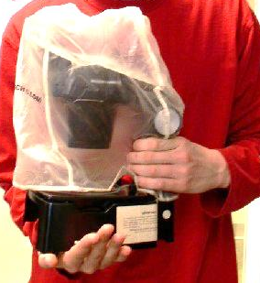
PARTS OF THE COMPOUND LIGHT MICROSCOPE
Arm
C
connects
It ________ the body tube to the base.
hand
One ____ should be around the arm when _______ the microscope
carrying
(the other should be under the ____).
base

Slide 9
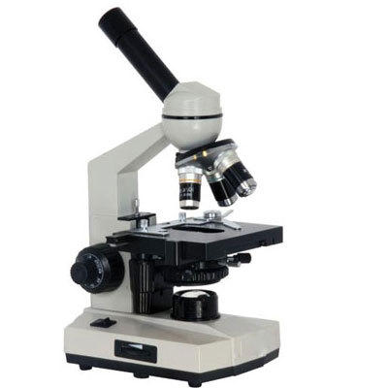
PARTS OF THE COMPOUND LIGHT MICROSCOPE
Base
It ________ the weight of the microscope.
supports
electronics
light source
It contains the _________ and __________.
D
under
One hand should be _____ the base while _______ the microscope
carrying
(the other hand should be holding the arm).

Slide 10
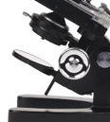
PARTS OF THE COMPOUND LIGHT MICROSCOPE
Light Source / Illuminator
mirror
upwards
It sends light _______ through the _____________
condenser lens
hole
E
and through the ____ in the stage
specimen
onto the ________ on the slide.
mirrors
Older microscopes used to use ______ to ______ the ambient light upwards.
reflect

Slide 11
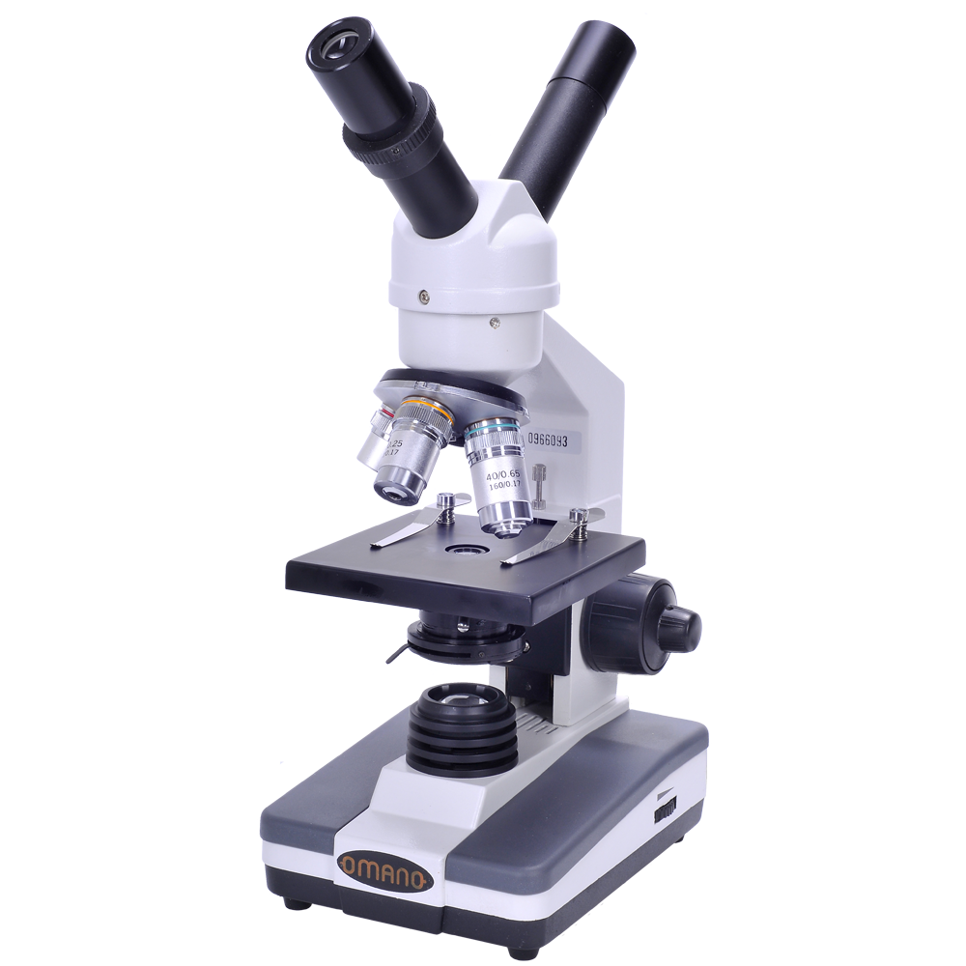
PARTS OF THE COMPOUND LIGHT MICROSCOPE
Objective Lenses
Low (scanning)
4 X
Medium
10 X
G
High
40 X
magnify
These lenses further _______ the image of the specimen.
4 X
10 X
The magnifications are usually ___ , ____ and ____ .
40 X
3
There are usually __ lenses

Slide 12
PARTS OF THE COMPOUND LIGHT MICROSCOPE
Coarse Adjustment Knob
H
first
The ____ knob you should use, and always under ___ power.
low
high
Never use it in ____ power.

Slide 13
PARTS OF THE COMPOUND LIGHT MICROSCOPE
Fine Adjustment Knob
H
I
first
The ____ knob you should use, and always under ___ power.
low
high
Never use it in ____ power.
second
The ______ knob you should use under ______ power
higher
exact
for _____ focusing.
stage
Both knobs move the _____ up and down
focus
to help put the specimen in _____.

Slide 14
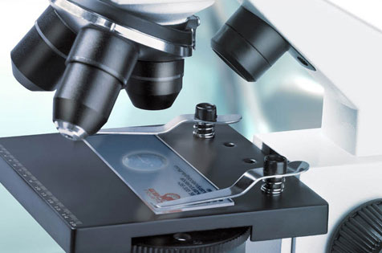
PARTS OF THE COMPOUND LIGHT MICROSCOPE
Stage
J
slide
The stage is where you place the ____ which contains the ________.
specimen
hole
It contains a ____ that allows ____ to pass through the stage and onto the specimen.
light

Slide 15
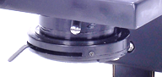
PARTS OF THE COMPOUND LIGHT MICROSCOPE
Condenser Lens
L
The lens under the stage that ___________ from the illuminator through to the ____ in the stage.
focuses light
hole

Slide 16
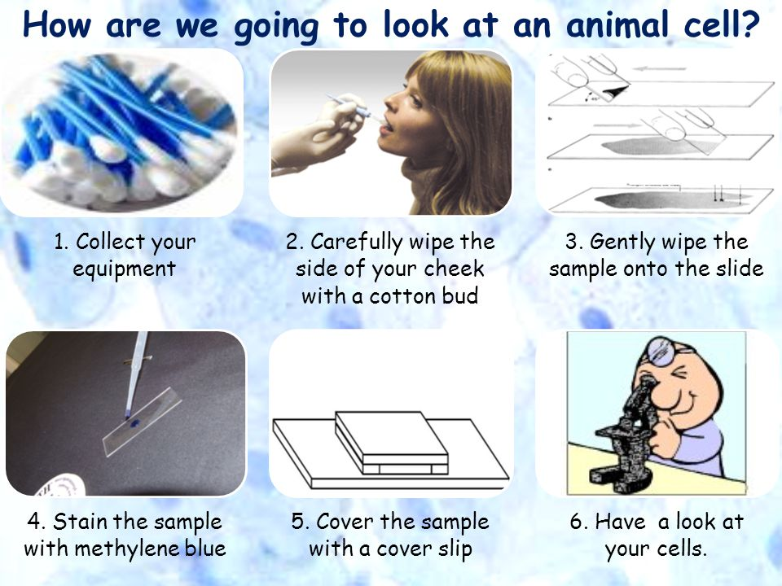

Slide 17
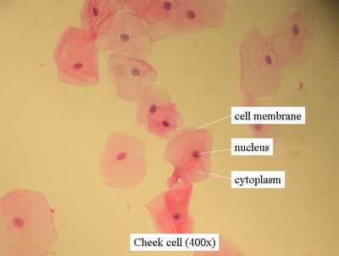
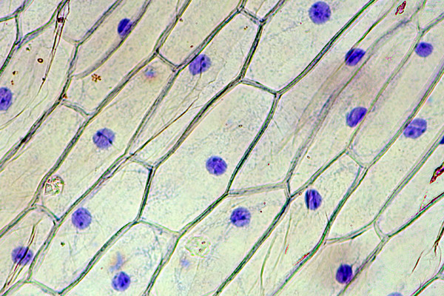
What you Should See

Slide 18
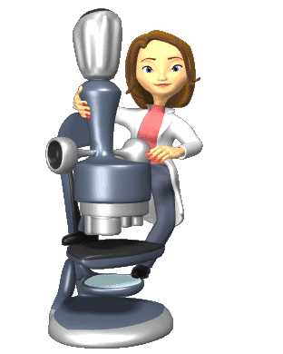
The End!

